Slide 1
NE 795-014: Advanced Reactor Materials
Fall 2023
Dr. Benjamin Beeler

Slide 2
Last Time
Talked through SiC
SiC is the primary fission product barrier/pressure vessel for TRISO particles
Low T radiation damage is primarily BSDs, Frank interstitial loops and voids start to form at medium to high temperatures

Slide 3
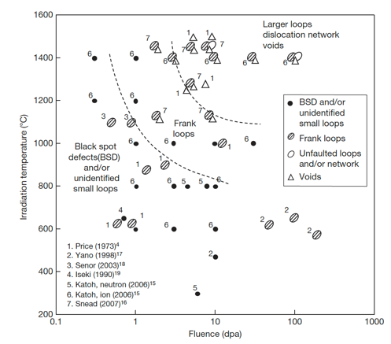
Low-Med T Radiation Effects in SiC
Above the critical amorphization temperature (423 K), the swelling increases logarithmically with dose until it reaches saturation
The saturation level decreases with increasing irradiation temperature
The dose exponents of swelling during the log period are often close to 2/3, in line with assumptions based on interstitial clusters
This temperature regime is referred to as the point-defect swelling regime and goes from critical amorphization temperature to about 1273 K
Tirr=300 C, 6 dpa
Dot number density 2.2e+24m-3
Mean dot diameter=1nm
Tirr= 800 C, 7.7 dpa
Loop number density 3.3e+23m-3
Mean loop diameter = 3.0 nm

Slide 4
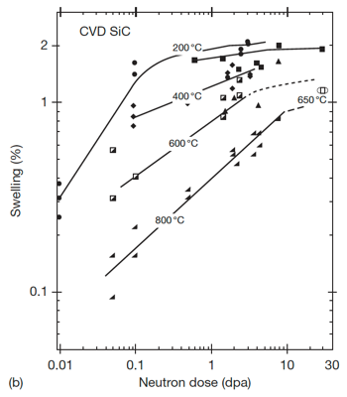
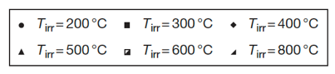
Saturation Swelling in SiC
Log swelling vs dose shown at right for CVD SiC irradiated in HFIR
The swelling of SiC is highly temperature dependent
at 1 dpa, saturation values from 200 C to 800 C vary by a factor of 5
The decrease in saturation with increasing T is due to increased recombination of defects
Swelling saturates at relatively low doses, less than 10 dpa

Slide 5
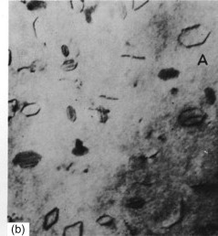
High T Radiation Effects in SiC
Above 1000C, Frank loops of the interstitial type become the dominant defects observed by TEM
Interstitial Frank loops are faulted, in that they include a stacking fault
Consequently, these loops cannot glide and will not move under an applied stress or temperature, and are therefore considered as sessile
At high temperature, the development of Frank loops into dislocation networks through unfaulting reactions at high doses is reported
Frank loops in Al

Slide 6
High T Radiation Effects in SiC
The volume associated with dislocation loops in irradiated SiC has been estimated to be on the order of 0.1%
At high T (greater than about 1500 K) vacancies are sufficiently mobile and vacancy clusters can be formed
This high T regime is the void swelling regime
1130 C, 1.8 dpa
1130 C, 8.5 dpa
1280 C, 5.0 dpa
1450 C, 1.8 dpa
1450 C, 5.0 dpa
1450 C, 8.5 dpa
Evolution of voids in high-temperature irradiated CVD SiC

Slide 7
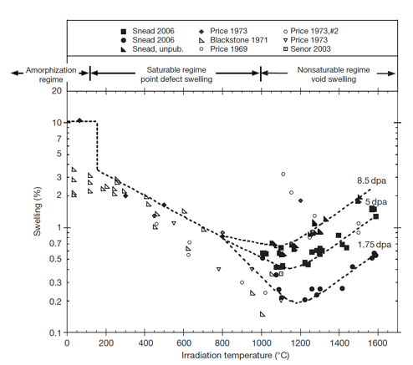
Irradiation-Induced Swelling in SiC
The transition from point-defect saturated swelling to void swelling occurs above 1000C
Void swelling increases as a function of dose, and is not known to saturate
The swelling near the critical amorphization temperature is described as the differential strain between the single interstitial, or tiny interstitial clusters, immobile vacancies, and antisite defects

Slide 8
Irradiation-Induced Swelling in SiC
Above the critical amorphization temperature, the number of defects surviving recombination is reduced and the mobility of both silicon and carbon interstitials becomes significant
Above 1000 C microstructural studies have noted the presence of both Frank loops and tiny voids, indicating limited mobility of vacancies
The max irradiation temperature shown is 0.65 T_{melt}

Slide 9
Irradiation-Induced Swelling in SiC
In typical fcc metal systems void swelling typically begins at ~0.35Tm, goes through a maximum value, and decreases to nil swelling by ~0.55Tm
The voids in SiC are continuing to grow in SiC irradiated to 1773 K, thus the energies for diffusion of either the Si or C vacancy or both must be quite high
This has been confirmed through DFT methods
It is unclear how swelling will increase as a function of dose above 10 dpa

Slide 10
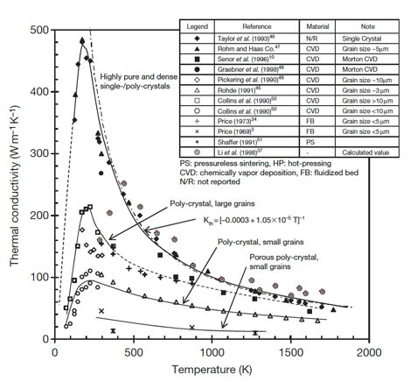
Thermal Conductivity Degradation
SiC is a ceramic with a band gap, and thus thermal conductivity is based on phonons
The conduction heat can be generally described by the strength of the individual contributors to phonon scattering: grain boundary scattering; phonon–phonon interaction; and defect scattering
Each of these types occurs at differing phonon frequencies and can be considered separable

Slide 11
Thermal Conductivity Degradation
The unirradiated k_{th} is highly dependent upon initial microstructure and temperature
Initial microstructure can be tailored, but the temperature dependence cannot be removed

Slide 12
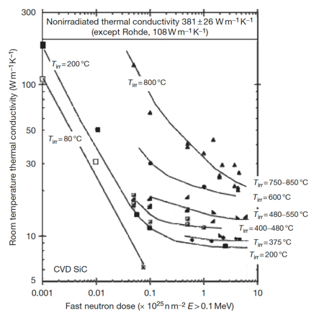
Thermal Conductivity Degradation
At low temperatures irradiation produces simple defects and defect clusters that very effectively scatter phonons
In this case, defect scattering quickly dominates, with saturation thermal conductivity typically achieved by a few dpa
Defect scattering is sufficiently present to eliminate the temperature dependence

Slide 13
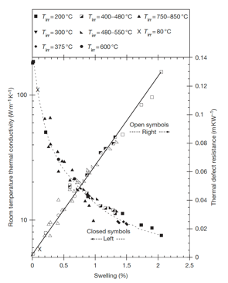
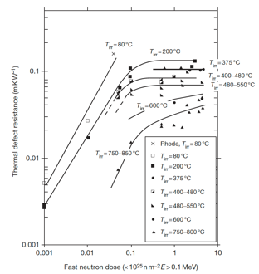
Thermal Conductivity Degradation
The thermal defect resistance is defined as the difference between the reciprocals of the irradiated and nonirradiated thermal conductivity (1/K_{rd} = 1/K_{irr} – 1/K_{nonirr})
This term can be related directly to the defect type and concentration present in irradiated ceramics
The thermal defect resistance is directly proportional to the irradiation-induced swelling in SiC, and is independent of temperature
This allows an indirect determination of thermal conductivity by measurement of the density change in the TRISO SiC shell

Slide 14
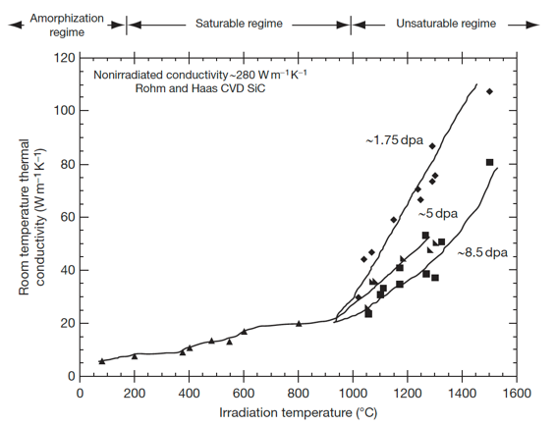
Thermal Conductivity Degradation
In the high temperature void swelling regime, thermal conductivity degradation is not expected to saturate, as voids continue to grow and scatter phonons
Additionally, the linear relationship between swelling and thermal defect resistance does not exist at high temperature
Generally, void swelling does not degrade thermal conductivity as severely as point defects, but data at high T is quite limited

Slide 15
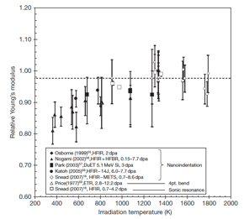
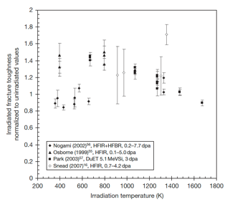
SiC Mechanical Properties
Irradiation generally reduces modulus to a greater extent for lower temperature irradiation, while the modulus reduction becomes negligible when irradiation temperature reaches or exceeds 1273 K
Irradiation-induced toughening (increase in fracture toughness) seems to be significant at 573–1273K in spite of the decrease in elastic modulus
However, there is significant scatter in the data

Slide 16
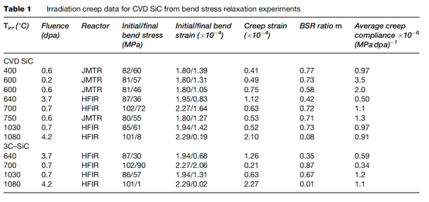
SiC Creep
Irradiation creep is defined as the difference in dimensional changes between a stressed and an unstressed sample irradiated under identical conditions
Studies on irradiation creep of SiC have been limited, although it is of high importance for SiC in TRISO particles
The creep strain for CVD SiC exhibited a weak temperature dependence at <0.7 dpa whereas a major transition at higher doses likely exists at higher temperatures

Slide 17
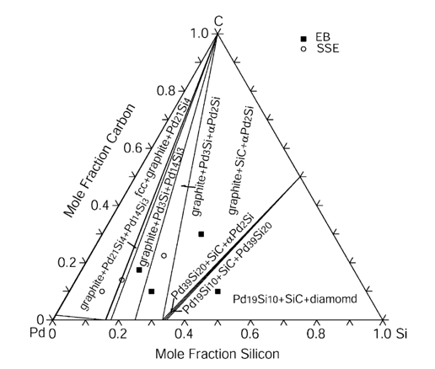
SiC Corrosion
The silicon carbide layer serves as a critical fission product barrier, but can be corroded by fission products, in particular palladium
Additionally, silver can be transported through intact SiC layers
For Pd, the reaction with SiC can be qualitatively explained by the phase-diagram, where a number of intermetallic structures are present
To prevent corrosion by Pd, new combinations of coating layers have been proposed

Slide 18
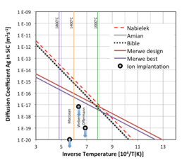
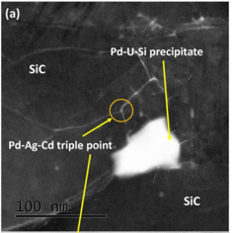
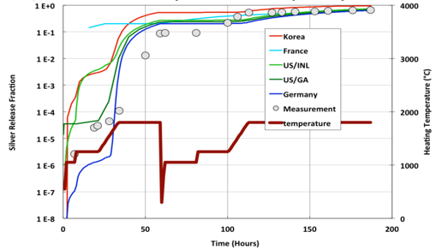
SiC Corrosion
Silver release has been observed from undamaged particles suggesting that Ag migrates through intact SiC layers at temperatures >1100 C
The Ag migration mechanism remains not fully understood, but is still an active area of research
Ag release has a temperature dependence, pointing towards a diffusive mechanism
From microstructural analyses, it seems possible that Ag, Cd and Pd cluster and transport together at grain boundaries and triple points because of their common chemical properties

Slide 19
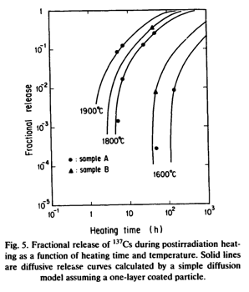
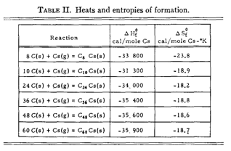
SiC Corrosion
Once cesium has migrated into the buffer, it can react with carbon
At nominal temperatures, cesium may be released and associated with carbon of the buffer layer to form compounds
These compounds, if they are not stable with increasing temperatures, may become a potential source of cesium release
Typically, cesium-graphite compounds are not stable at 923 K under vacuum and decompose to give cesium vapor and graphite

Slide 20
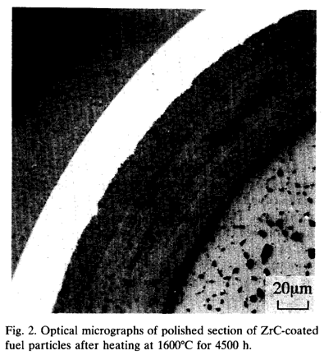
SiC vs ZrC Corrosion
An approach to counteract SiC fission product corrosion is to replace the SiC coating by a ZrC layer
Experimental observations showed neither Pd attack nor thermal degradation of ZrC up to 1600C
ZrC was also shown to have a high capacity to retain Cs, but poor retention of Ru
At higher T, the deterioration of the ZrC particle is caused by failure of the IPyC
The development of TRISO with ZrC-coating is at an early stage compared to the SiC-coated design

Slide 21
Questions?

Slide 22
Graphite

Slide 23
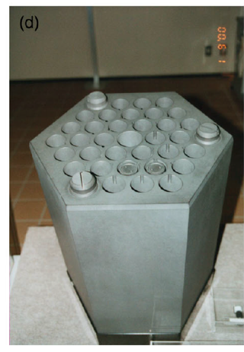
Graphite Usage
Graphite was the moderator in the first reactor to sustain a chain reaction and has been used as a moderator in over 100 nuclear reactors, many of which are still operating
Graphite has a high neutron scattering cross-section and a very low neutron absorption cross-section, making it an ideal moderator

Slide 24
Delineate Types of Graphite
TRISO Graphite
CVD deposition
treated to ensure ultra dense and high purity
Prismatic Blocks and Pebbles
large scale
different fabrication process from TRISO
different microstructure
We will generally be talking about graphite, which most directly applies to prismatic block type graphite
Similar radiation effects are assumed to occur in PyC layers

Slide 25
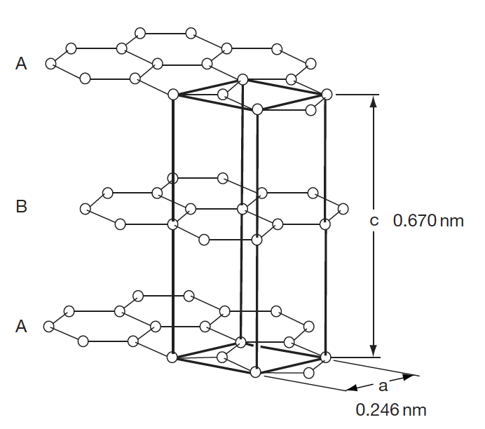
Graphite Structure
The electronic hybridization of carbon atoms (1s2, 2s2, 2p2) allows several types of covalent-bonded structures
In graphite, we have sp2 hybridization where the carbon atom is bound to three equidistant nearest neighbors in a given plane to form the hexagonal graphene structure
The sheets are weakly bound with van der Waals type bonds in an ABAB stacking sequence with a separation of 0.335 nm

Slide 26
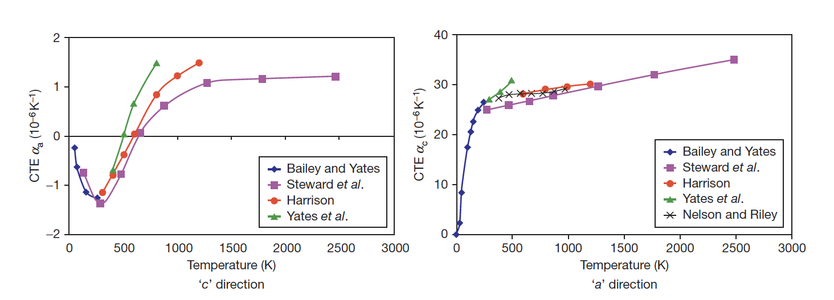
Fundamental Properties
The CTE for graphite displays anisotropic behavior, and strongly varies as a function of temperature
Due to the structure the strength along the basal planes is higher than the strength perpendicular to the planes, and the shear strength between the basal panes is relatively weak
The thermal conductivity along the basal planes is much greater than perpendicular to the planes

Slide 27
Mrozowski Cracks
During the manufacture of artificial graphite, very high temperatures (2800–3000 C) are required
Upon cooling, the anisotropy in thermal expansion coefficients leads to the formation of long, thin microcracks parallel to the basal planes, often referred to as ‘Mrozowski’ cracks
The presence of these microcracks is very important in understanding the properties of nuclear graphite
These cracks for in both TRISO PyC, sometimes called highly orientated pyrolytic graphite (HOPG), and standard nuclear graphite

Slide 28
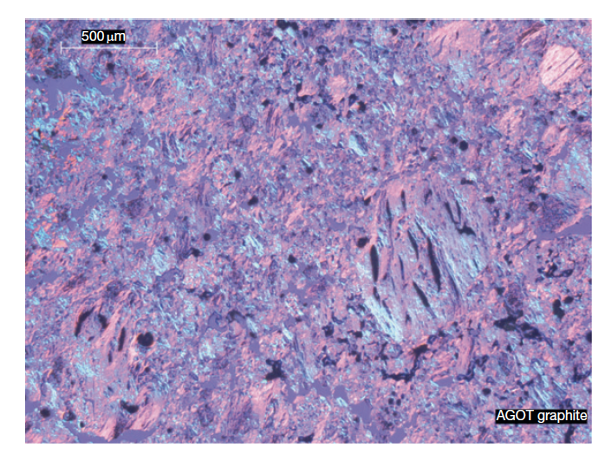
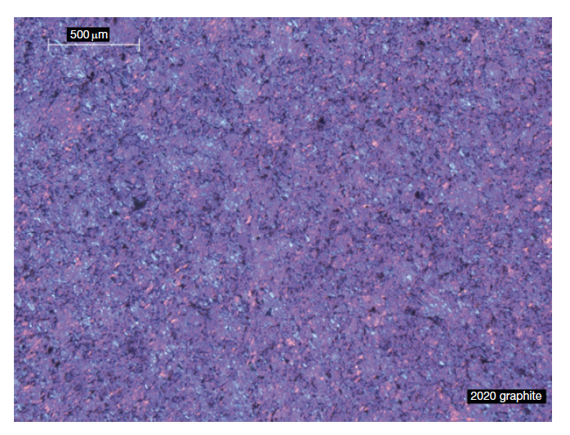
Graphite Texture
Graphite structure is largely dependent upon the manufacturing process
Graphites are classified according to their grain size from coarse-grained (containing grains in the starting mix that are generally >4mm) to microfine-grained (containing grains in the starting mix that are generally <2 mm)
Grade AGOT was used as the moderator in the earliest nuclear reactors in the United States
2020 graphite was a candidate for the core support structure of the modular high temperature gas-cooled reactor in the United States

Slide 29
Initial Porosity
A dominant feature of graphite texture is the amount of porosity
About half the total porosity is open to the surface
The formation of pores and cracks in the graphite during manufacture adds to the texture arising from grain orientation and causes anisotropy in the graphite physical properties
Three origins of porosity:
Those formed by incomplete filling of voids
Gas entrapment during pyrolysis
Thermal cracks

Slide 30
RADIATION EFFECTS IN GRAPHITE

Slide 31
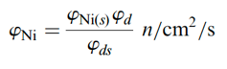
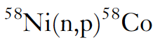
Graphite Shrinkage
When graphite components are irradiated in a reactor, significant changes to their dimensions and properties occur
The unit of irradiation exposure EDND used in the figures is particular to nuclear graphite technology
EDND = Equivalent DIDO Nickel Dose
EDNF = Equivalent DIDO Nickel Flux
They are based upon the equivalent nickel activation in the DIDO reactor

Slide 32
Graphite Shrinkage
Graphite typically shrinks with age until a point is reached where the shrinkage stops, and the graphite starts to swell
This change from shrinkage to swelling is known as "turnaround”
Due to the manufacturing process of nuclear graphite, the graphite component has a much lower density than may be expected (1.7-1.9 g/cm3) compared with 2.2.6 g/cm3 for pure graphite crystals
The original state of the graphite, and the particular radiation defects in graphite, govern this fluence-dependent behavior

Slide 33
Graphite Dimensional Change
Dimensional change data obtained on AGR graphite samples are shown in figure
The higher the temperature the sooner ‘turnaround’ from shrinkage to swelling occurs
This behavior is typical for most semi-isotropic, medium and fine-grained graphite grades, although the magnitude of the changes varies from grade to grade
Nuclear graphite, such as Glisocarbon, is semi-isotropic
Anisotropic graphite can display significantly different irradiation behavior

Slide 34
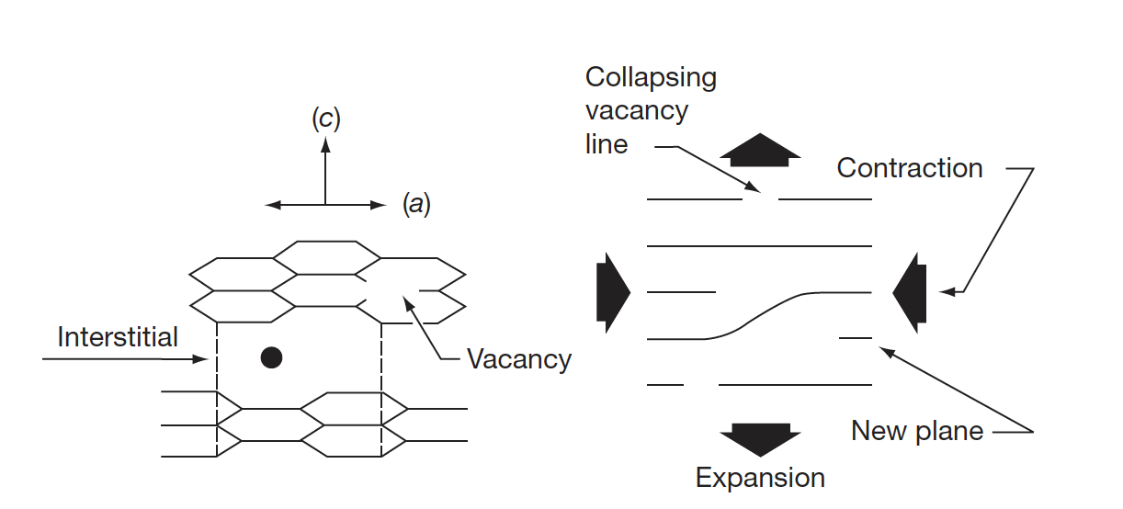
Interstitials in Graphite
The interstitial atom prefers to form a bridge-like structure on the graphene surface
Repelling the two graphene sheets increases c, yielding a corresponding contraction in a
Vacancies shrink the basal plane, further reducing a
Turnaround occurs when the matrix can no longer accommodate the defect-induced dimensional change

Slide 35
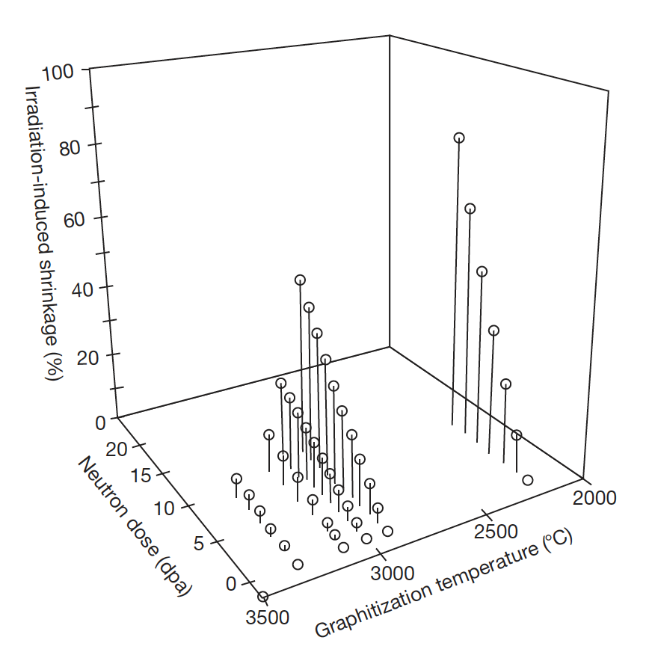
Graphite Shrinkage
Nuclear graphite possess a polycrystalline structure, usually with significant texture resulting from the method of forming during manufacture
Thermal shrinkage cracks that occur during manufacture and that are preferentially aligned in the crystallographic a-direction will initially accommodate the c-direction expansion
So a direction contraction will be observed, and graphite thus undergoes net volume shrinkage
With increasing neutron dose (displacements), the incompatibility of crystallite dimensional changes leads to the generation of new porosity, and the volume shrinkage rate falls, eventually reaching zero
The graphite now begins to swell at an increasing rate with increasing neutron dose

Slide 36
Graphite Irradiation Under Loading
If graphite is irradiated under load the dimensional change data are modified
The difference between loaded and unloaded dimensional change is referred to as creep
The shrinkage is increased under compression and reduced under tension
With increasing fluence the creep strain increases fairly linearly at first, and then the rate reduces before finally increasing

Slide 37
CTE and Young’s Modulus
The behavior of the CTE and E is complex and differs between anisotropic and semi-isotropic grades
The CTE of Gilsocarbon first increases then reduces
For E there an increase with increasing fluence for Glisocarbon
If irradiated past turnaround, significant degradation occurs and the modulus starts to reduce
PGA = Pile Grade A, course, anisotropic graphite
PGA
Glisocarbon

Slide 38
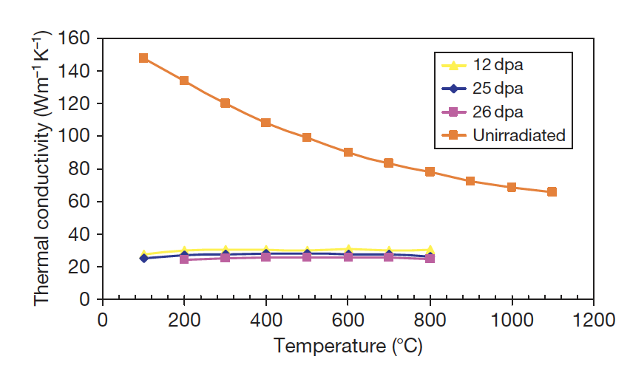
Thermal Conductivity
Graphite is a phonon conductor of heat
Similar to SiC, larger grain size, theoretical densities, low defect content, improve k
The increase of thermal resistance due to irradiation damage has been ascribed to the formation of (1) small interstitial clusters, (2) vacancies, (3) vacancy loops
At any irradiation temperature, the decreasing thermal conductivity will reach a ‘saturation limit’

Slide 39
Impacts of Changes Under Irradiation
In graphite moderated reactors, the graphite structure provides channels for fuel, fuel-cooling and control rod entry, the structural integrity of the graphite components is important from safety and lifetime considerations
Components develop stresses which need to be accounted for
Temperature distribution across a graphite channel is shown at the right
Fluence also changes radially
Fuel is in the center (bore)

Slide 40
Impacts of Changes Under Irradiation
Properties and dimensions change as a function of both temperature and fluence
First, the graphite brick will shrink faster at the bore than at the outside, and properties will vary radially
Graphite brick internal shrinkage and thermal stresses are generated; first tensile at the bore and compressive at the outside, and then reversing in sign towards the end of reactor life
Fortunately much of this stress is reduced by irradiation creep

Slide 41
Impacts of Changes Under Irradiation
Discontinuities in the figure are due to shutdowns every 2 years
The difference in CTE between the inside and the outside of the brick, along with irradiation creep, causes the stresses to significantly change when the reactor is shutdown and the graphite cools
The change in stress at shutdown is mainly due to the temperature difference across the brick, which creep out during reactor operation
Towards the EOL, this leads to significantly different stress states for the inside/outside of the graphite brick

Slide 42
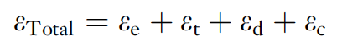
Irradiation Creep
Graphite will undergo creep (inelastic strain) during neutron irradiation and under stress at temperatures where thermal creep is generally negligible
Creep is so fundamentally important to graphite that if irradiation-induced stresses in graphite moderators could not relax via radiation creep, rapid core disintegration would result
One study showed that a 50% decrease in the assumed creep strain resulted in a 50% increase in the predicted hoop stress in a hollow cylindrical core brick
The total strain, in a graphite component under irradiation in a reactor core is given by:
where ε_{e} is the elastic strain; ε_{t}, the thermal strain; ε_{d}, the dimensional change strain; and ε_{c} is the creep strain

Slide 43
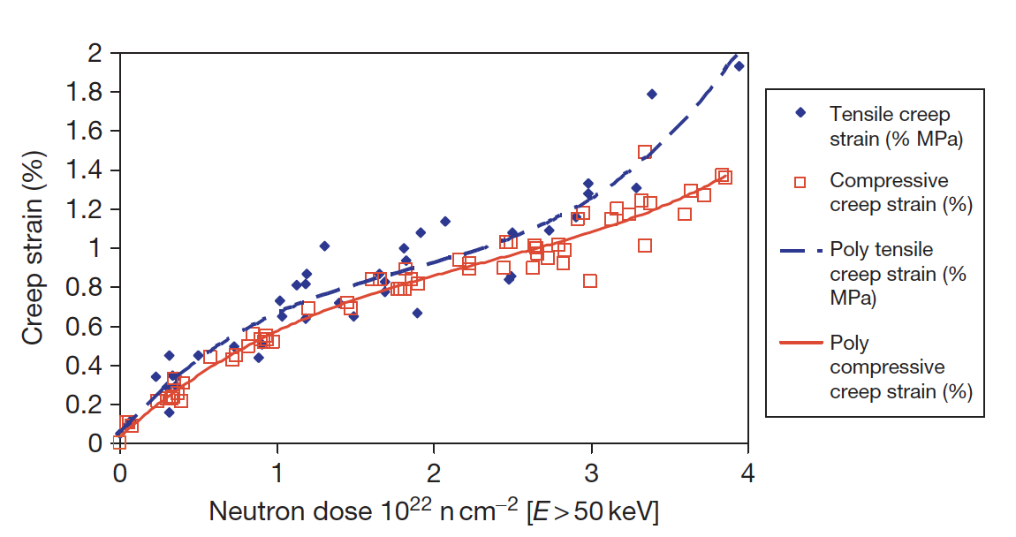
Irradiation Creep
Because of the significance of irradiation-induced creep to the stress levels in graphite core components, accurate models of creep have long been sought, but current models tend to break down at high temperature and fluence
Stress state (compressive/tensile) has an impact on the creep rate
The creep rate increases more rapidly in the tensile loading case compared to the compressive case at high dose

Slide 44
Irradiation Creep
Irradiation-induced basal plane dislocation pinning/unpinning in the graphite crystal is the expected mechanism for the irradiation-induced creep
The pinning points are speculated to be interstitial atom clusters
The interstitial clusters are temporary barriers as they are destroyed by further irradiation
The concentration of pinning sites increases under irradiation from the initial value to a steady-state concentration
The initial creep rate is high and decreases to a near steady-state value as the pinning concentration saturates at a level controlled by the neutron flux and temperature
At high dose, the creep rate can again increase because of (1) high internal stress enhancing the creep rate, and (2) the destruction of interstitial pins by thermal diffusion of vacancies

Slide 45
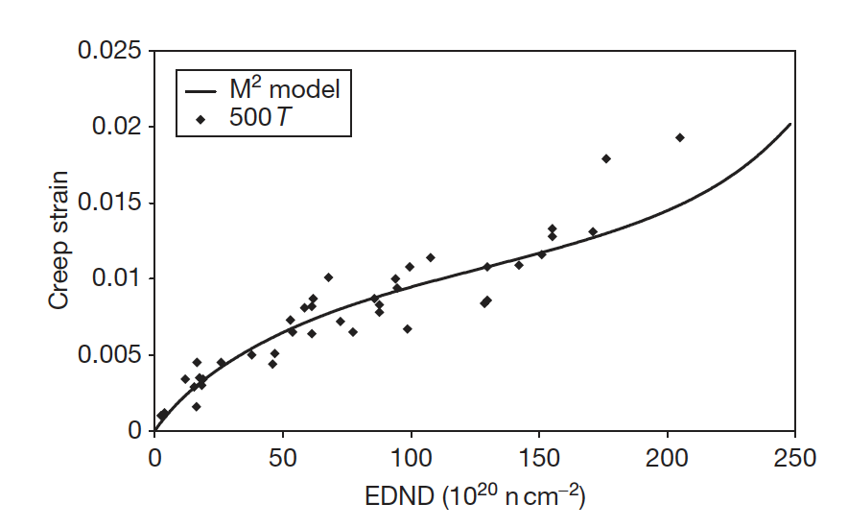
Irradiation Creep Models
Since creep is so important to graphite, a number of creep prediction models have been developed:
Linear viscoelastic creep, UK creep, Kennedy, Kelly and Burchell, etc.
These models can take into account evolving pore structure, thermal expansion, recoverable strain, etc.
The M² model potentially performs the most accurately as a function of dose at relatively low temperatures
However, no model is sufficiently accurate at both high dose and high temperature

Slide 46
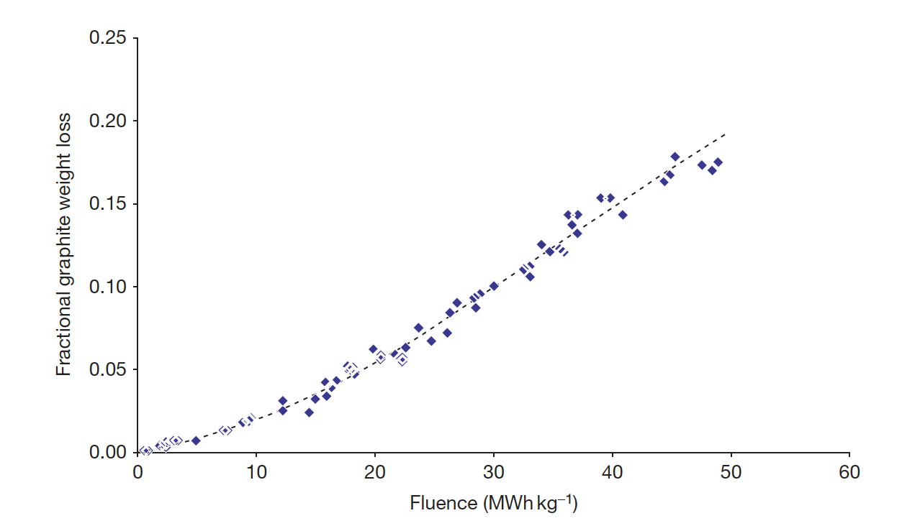
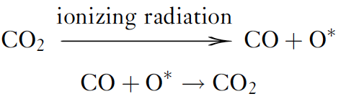
Radiolytic Oxidation
In carbon dioxide (CO2)-cooled reactors, two types of oxidation can occur: thermal and radiolytic
Radiolytic oxidation occurs when CO2 is decomposed by ionizing radiation (radiolysis) to form CO and an active oxidizing species (something like CO3), which attacks the graphite
Radiolytic oxidation occurs predominantly within the graphite open porosity
Can result in weight loss and wastage from graphite

Slide 47
Fabrication

Slide 48
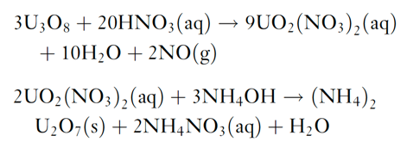
Fuel Kernel Fabrication
The sol–gel technique for kernel microsphere preparation is based on the following two chemical reactions starting from U3O8 powder
The (NH4)2U2O7 (ammonium di-uranate – ADU) is converted to UO2 by sintering in hydrogen gas
For the production of UCO kernels, carbon black is added to the broth and the sintering is performed in CO gas to ensure adequate C/O stoichiometry

Slide 49
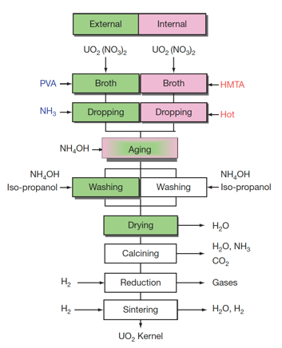
Fuel Kernel Fabrication
The mechanical strength of the coated layers depends on their thickness and sphericity, and thus strongly depend on the diameter and sphericity of the kernels
Vibrating nozzles from which droplets are emitted with high speed were developed for uniform and spherical kernel fabrication
A process is applied to prevent the deformation of droplets while they are landing on the ammonia water, where droplets are solidified while falling in ammonia gas blown against them

Slide 50
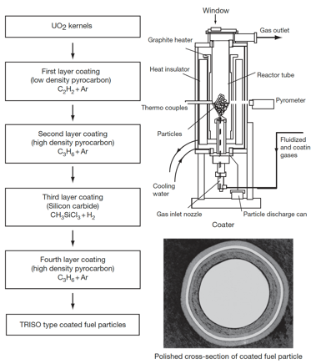
SiC (and PyC) Fabrication
The coating technology of both the SiC and PyC layers involves a fluidization of the kernel microsphere bed and chemical vapor deposition (CVD) coating
TRISO coating process is divided into four coating processes for the porous PyC, IPyC, SiC, and final OPyC layers
A specific mixture of gases is used for the deposition of each layer
buffer: C2H2+Ar; IPyC/OPyC: C3H6+Ar; SiC: CH3SiCl3+H2

Slide 51
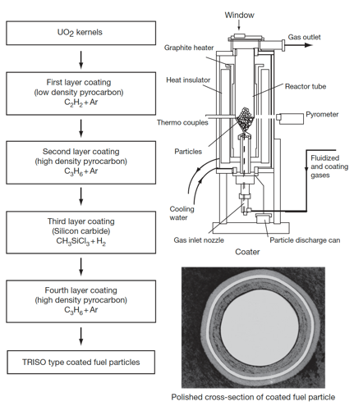
TRISO Fabrication
Rigorous control is applied at every step of the fabrication process to produce high-quality, very low-defect fuel
Defect levels are typically on the order of one defect per 100,000 particles
Specifications are placed on the diameters, thicknesses, and densities of the kernel and layers; the sphericity of the particle; the stoichiometry of the kernel; the isotropy of the carbon; and the acceptable defect levels for each layer

Slide 52
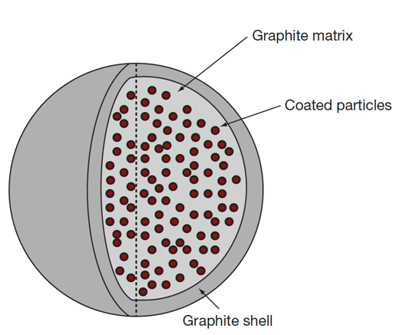
Pebble and Compact Fabrication
The fuel element of the pebble bed type HTGR is a spherical fuel element
The coated particles are overcoated with a layer of matrix graphite powder (MGP) and pressed to the core of a fuel sphere
Then, an additional 5-mm layer of matrix graphite material is added to form a ‘nonfuel’ zone
The resulting fuel sphere gets its final diameter by a machining process and is then carbonized and annealed at 2000C

Slide 53
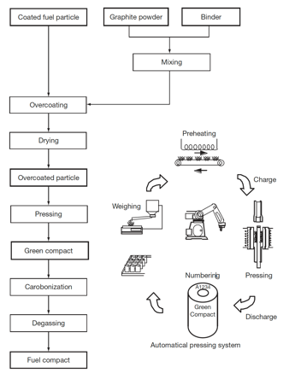
Pebble and Compact Fabrication
HTGR fuel elements are graphite compacts stacked into a graphite core
To form compacts, coated fuel particles are overcoated with the MGP and warm-pressed to make the annular cylinder of green compacts
Green compacts are heat treated for carbonization at 800C and then sintered at 1800C to make fuel compacts
In order to decrease the failure fraction of coating layers, it is necessary to disperse coated fuel particles in a green compact as uniformly as possible

Slide 54
Summary
Graphite day
Graphite has a lot of texture and porosity, dependent upon fabrication
Graphite shrinks, then undergoes turnaround
This behavior is governed by point defects and Mrozowski cracks
Turnaround happens quicker at higher temperatures, and it dependent upon applied stress
Irradiation creep is critically important in graphite
Fabrication of pebbles/compacts

